Slide 1


VISVESVARAYA TECHNOLOGICAL, UNIVERSITY
JNANA SANGAMA, BELAGAVI- 590018
Add-on course mini project report on
“GENERAL STOCK MANAGEMENT SYSTEM USING C LANGUAGE“
Submitted in partial fulfillment of the requirement for the award of the degree of
BACHELOR OF ENGINEERING
IN
COMPUTER SCIENCE AND ENGINEERING
Submitted by
ABHISHEK SAVANT 2VD20CS003
ADITYA A WADKAR 2VD20CS004
Under the guidance of
PROF. SALEEM HEBBAL
PROF. ABHAYKUMAR INCHAL
DEPARTMENT OF COMPUTER SCIENCE AND ENGINEERING
KLS VISHWANATHARAO DESHPANDE INSTITUTE OF TECHNOLOGY,
HALIYAL-581329
2021-2022

Slide 2
KLS VISHWANATHARAO DESHPANDE
INSTITUTE OF TECHNOLOGY, HALIYAL-581329
DEPARTMENT OF COMPUTER SCIENCE AND ENGINEERING
CERTIFICATE
Certified that the project work entitled
“GENERAL STOCK MANAGEMENT SYSTEM USING C LANGUAGE “
A Bonafide work carried out by
ABHISHEK SAVANT (2VD20CS003) ADITYA A WADKAR(2VD20CS004)
In partial fulfillment of the requirement for the award of Bachelor Of Computer Science And Engineering Visvesvaraya Technology University, Belagavi ,during the year 2021-2022. It is certified that all the corrections/suggestion indicated for the internal assessment have been incorporated in the report. The project work report has been approved has it satisfies the academic requirements in the respect of the project work prescribed for the Bachelor of Engineering degree
Signature of guide
Seal of principal
Signature of HOD
Prof. Saleem Hebbal
Prof. Abhaykumar Inchal
Dr. V.A. Kulkarni
Prof. Poornima Raikar
1
2

Slide 3
ACKNOWLEDGEMENT
First of all, we are indebted to the ALMIGHTY GOD for giving us an opportunity to excel in our efforts to complete this project on time .
Our heartfelt gratitude to our guide, Prof. Saleem Hebbal and Prof. Abhaykumar Inchal , computer science and engineering department for the valuable suggestion and guidance in the preparation of the project .
We are extremely grateful to Prof. Poornima Raikar ,Head of computer science and engineering department, for providing all the required resources for the successful completion of the project .
We are truly grateful to Dr. V.A. Kulkarni , Principal, KLS’s Vishwanatharao Deshpande Institute of Technology ,Haliyal for providing all the necessary resources for the successful completion of the project .
We express our thanks to all the staff and friends for all the help and co-ordination extended in bringing out this project successfully in time .
We will be failing in duty if we do not acknowledge with the grateful thanks to the authors of the references and other literature referred to in this project. last but not the least, we are very much thankful to our parents who guided us in every step which we took .
-Project Associates
Abhishek Savant
Aditya A Wadkar

Slide 4
TABLE OF CONTENT
Acknowledgement i
Abstract ii
Index iii

Slide 5
ABSTRACT

Slide 6
INDEX
Chapter 1 Introduction
1.1 Objective
Chapter 2 Problem Definition
Chapter 3 Methodology
3.1 Algorithm
Chapter 4 System Implementation
Code Blocks
Chapter 5 Result
Chapter 6 Conclusion

Slide 7
PROBLEM STATEMENT
AN ELECTRONIC SHOP FACED FOLLOWING PROBLEMS:
Maintaining the details of Purchased stock of a product.
Maintaining the details of how many product .
Generating Sales and Purchase report.
Generating Stock report of a remaining product.

Slide 8
INTRODUCTION
This project is aimed at developing a desktop based application named Stock Management System for managing the stock system of any organization. The Stock Management System refers to the system and processes to manage the stock of organization with the involvement of Technology system. This system can be used to store the details of the stock, stock maintenance, update the stock based on the sales details, and generate sales and stock report daily or weekly based. This project is categorize individual aspects for the sales and stock management system.
In this system we are solving different problem affecting to direct sales management and
purchase management. Stock Management System is important to ensure quality control in businesses that handle transactions resolving around consumer goods.
Without proper stock control, a large retail store may run out of stock on an important item. A good stock management system will alert the wholesaler when it is time to record. Stock Management System is also on important for automatically tracking large shipment. An automated Stock Management System helps to minimize the errors while recording the stock.
In our mini project,as we are mainly focusing on maintaining record of stock,Initially Menu appears.From the Menu, We need to make our choice that we need to give input . for purchase or sales quantity.As we select 1,program displays input for number of stock entries,Bill No.,Date,Item,Purchase Quantity and Price.And even for Sales Quantity,inputs are same except for Sales Quantity for 2nd Choice.For 3rd choice,remaining stocks are displayed after selling purchased stocks.

Slide 9
ALGORITHM
Step 1: Start
Step 2: Variable declaration BILL No.,pqty,sqty,day,month,year,Item,Price,Stock,Choice
Step 3: do
read choice
switch (choice)
case 1: read purchase entry
break;
case2: read sales entry
break;
case 3:read stock entry
if(s[i].pqty>=s[i].sqty)
{
print("\n\t\t\t\t\t\t\tITEM\t\t\tPQTY\t\tSQTY\t\tSTOCK\n");
for(i=0;i<n;i++)
{
stock=s[i].pqty-s[i].sqty;
if(stock==0)
print(“\t\t\t\t\t%s\t\t%d\td\t%d\n”,s[i].item,s[i].pqty,s[i].sqty,stock);
}
else if(stock<0)
{
print("\t\t\t\t\t\t\t%s\t\t%d\t\t%d\t\tStock is
unavailable\n",s[i].item,s[i].pqty,s[i].sqty,stock);
}
else
{ print("\n\n\t\t\t\t\t\t\t%s\t\t%d\t\t%d\t\t%d\n",s[i].item,s[i].pqty,s.[i].sqty,stock);
}
}
}
break;
case 4: read Thank You
Step 4: end do while
Step 5: Stop

Slide 10
PROGRAM
#include<stdio.h>
#include<stdlib.h>
#include<string.h>
struct stock
{
int BillNo,pqty,sqty;
int day;
int month;
int year;
char item[40];
float price;
};
struct stock s[50];
int main()
{
int stock;
int choice;
int a[50],i,n,m;
do{
printf("\t\t\t\t\t\t\t\###############################################################");
printf("\n\t\t\t\t\t\t\t\t\t\t\tMENU\n");
printf("\t\t\t\t\t\t\t\###############################################################");
printf("\n\t\t\t\t\t\t\t\t\t\t\t1.Purchase entry\n");
printf("\t\t\t\t\t\t\t\t\t\t\t2.Sales entry\n");
printf("\t\t\t\t\t\t\t\t\t\t\t3.Stocks\n");
printf("\t\t\t\t\t\t\t\t\t\t\t4.Exit\n");
printf("\t\t\t\t\t\t\t\###############################################################");
printf("\n\t\t\t\t\t\t\t\t\t\t\tEnter your choice\n");
printf("\t\t\t\t\t\t\t\t\t\t\t");
scanf("%d",&choice);
switch(choice)
{
case 1:printf("\t\t\t\t\t\t\t\t\t\t\tPurchase Entry\n");
printf("\t\t\t\t\t\t\t\t\t\t\tnumber of entries\n");
printf("\t\t\t\t\t\t\t\t\t\t\t");
scanf("%d",&n);
for(i=0;i<n;i++)
{
printf("\n\t\t\t\t\t\t\t\t\t\t\tBillNo=");
scanf("%d",&s[i].BillNo);
printf("\t\t\t\t\t\t\t\t\t\t\tDATE=");
scanf("%d-%d-%d",&s[i].day,&s[i].month,&s[i].year);

Slide 11
printf("\t\t\t\t\t\t\t\t\t\t\tITEM=");
scanf("%s",s[i].item);
printf("\t\t\t\t\t\t\t\t\t\t\tPQTY=");
scanf("%d",&s[i].pqty);
printf("\t\t\t\t\t\t\t\t\t\t\tPRICE=");
scanf("%f",&s[i].price);
}
printf("\t\t\t\t\t\t\t\t\t\t\tBILLNO\tDATE\t\tITEM\t\tPQTY\tPRICE\n");
for(i=0;i<n;i++)
{
printf("\t\t\t\t\t\t\t\t\t\t\t%d\t%d-%d-
%d\t%s\t%d\t%f\n",s[i].BillNo,s[i].day,s[i].month,s[i].year,s[i].item,s[i].pqty,s[i].price);
}
break;
case 2:printf("\t\t\t\t\t\t\t\t\t\t\tSales Entry\n");
for(i=0;i<n;i++)
{
printf("\n\t\t\t\t\t\t\t\t\t\t\tBillNo=");
scanf("%d",&s[i].BillNo);
printf("\t\t\t\t\t\t\t\t\t\t\tDATE=");
scanf("%d-%d-%d",&s[i].day,&s[i].month,&s[i].year);
printf("\t\t\t\t\t\t\t\t\t\t\tSQTY=");
scanf("%d",&s[i].sqty);
printf("\t\t\t\t\t\t\t\t\t\t\tPRICE=");
scanf("%f",&s[i].price);
}
printf("\t\t\t\t\t\t\t\t\t\t\tBILLNO\tDATE\t\t\tITEM\t\tSQTY\tPRICE\n");
for(i=0;i<n;i++)
{
printf("\t\t\t\t\t\t\t\t\t\t\t%d\t%d-%d-
%d\t%s\t%d\t%f\n",s[i].BillNo,s[i].day,s[i].month,s[i].year,s[i].item,s[i].sqty,s[i].price);
}
break;
case 3:printf("\t\t\t\t\t\t\t\t\t\t\tStocks\n");
if(s[i].pqty>=s[i].sqty)
{
printf("\n\t\t\t\t\t\t\tITEM\t\t\tPQTY\t\tSQTY\t\tSTOCK\n");
for(i=0;i<n;i++)
{
stock=s[i].pqty-s[i].sqty;
if(stock==0)
printf(“\t\t\t\t\t%s\t\t%d\td\t%d\n”,s[i].item,s[i]. pqty,s[i].sqty,stock);
}
else if(stock<0)
{

Slide 12
printf("\t\t\t\t\t\t\t%s\t\t%d\t\t%d\t\tStock is
Unavailable\n",s[i].item,s[i].pqty,s[i].sqty,stock);
}
else
{
printf("\n\n\t\t\t\t\t\t\t%s\t\t%d\t\t%d\t\t%d\n",s[i].item,s[i].pqty,s[i].sqty,stock);
}
}
}
break;
case 4:printf("Thank you");
break;
}
}while(choice<=3);
}

Slide 13
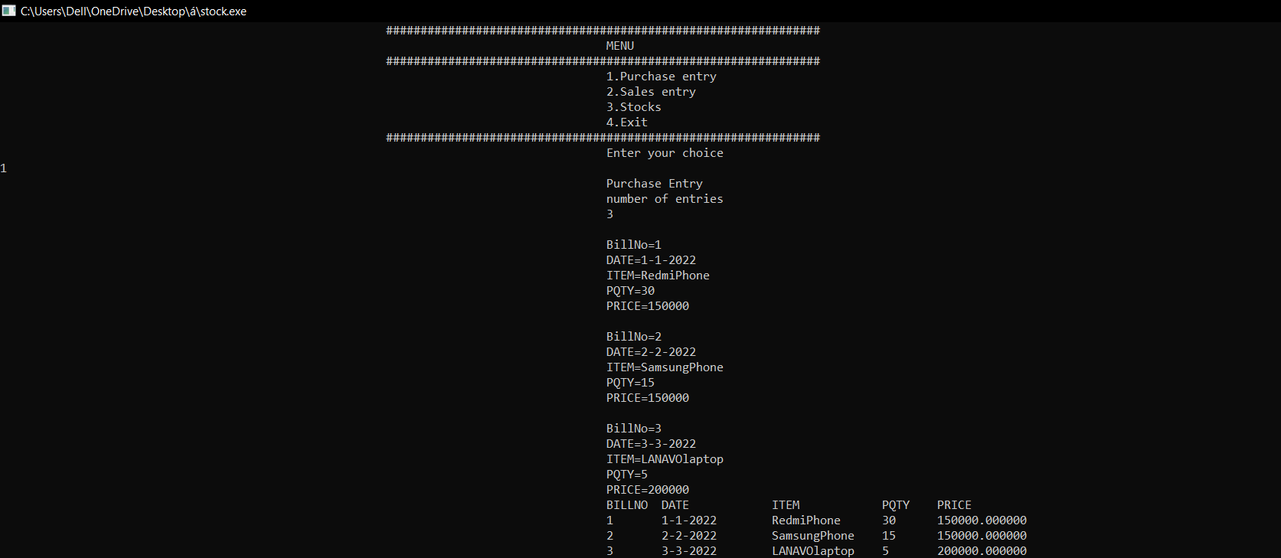
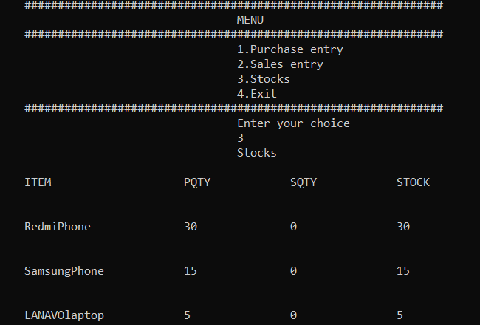
OUTPUT

Slide 14
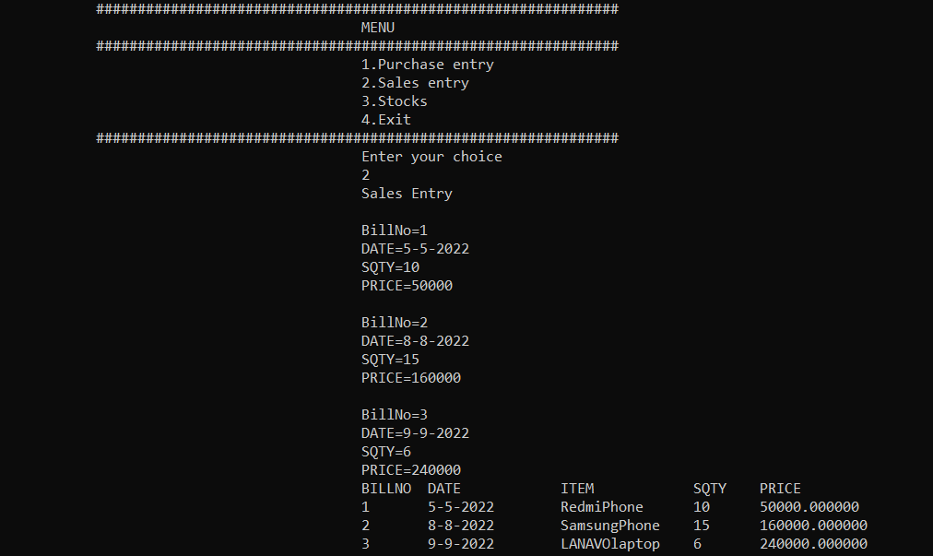
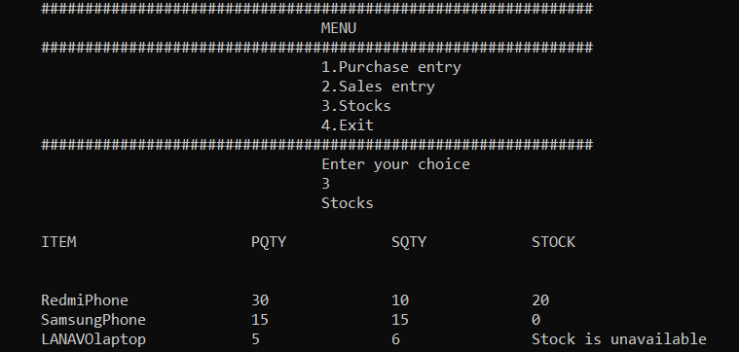
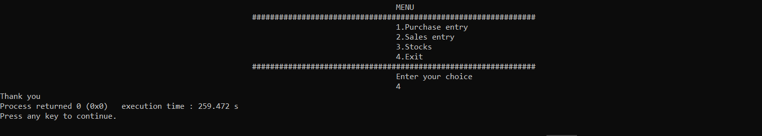

Slide 15
CONCLUSION :
This System provides the Purchase report ,Sales report of the product and provides the Stock report after automatically calculating how many stock is remaining after selling the product and it
also save the time and energy required to do these work manually .

